Slide 1
Battle of Neighborhoods with Universities in Toronto
Weiran Zhao
Feb 1, 2021

Slide 2
1. Introduction
Background:
Toronto is a metropolis with lots of universities and about 87,083 student population,
Large number of potential customers.
Problem:
By comparing the neighborhoods with different universities in Toronto city, we will have a view of the similarities and differences of venues categories in the neighborhoods. Therefore, businessmen can have a better view of the surrounding area.
Purpose:
Make data driven discussions, chose location, or change business strategy.

Slide 3
2. Data
Data Sources:
Toronto neighborhood data - Wikipedia page
Foursquare API
Data Features:
Arts & Entertainment, Event, Food, Nightlife Spot, Outdoors & Recreation, Professional & Other Places, Residence, Shop & Service, Travel & Transport.
Universities addresses

Slide 4
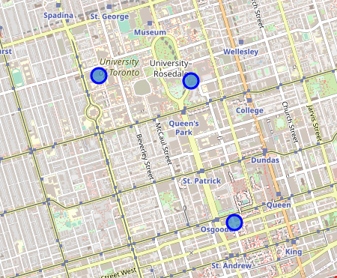
3. Exploratory Data Analysis
Toronto map and universities neighborhood locations

Slide 5
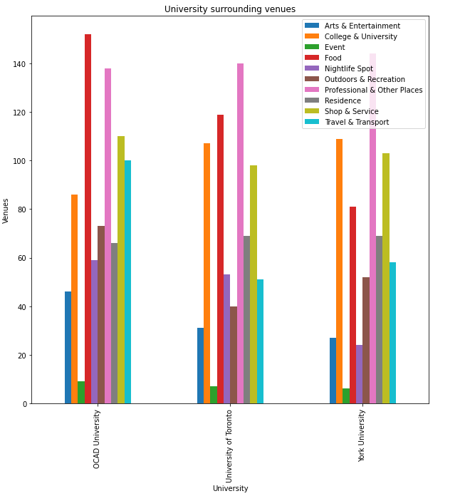
3. Exploratory Data Analysis
Bar chart of universities surrounding venues
have almost same number of Professional & Other places, Shop & Service, Residence and a small number of Event venues.
York University have a smaller number of Food and Nightlife Spots.

Slide 6
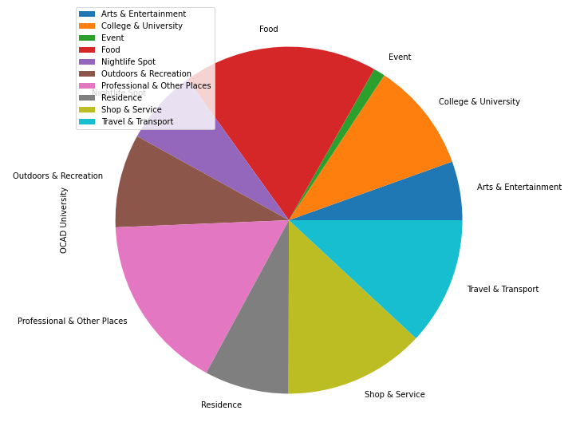
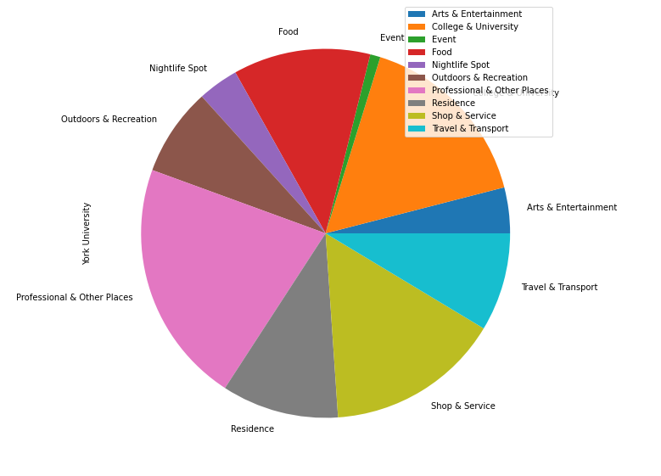
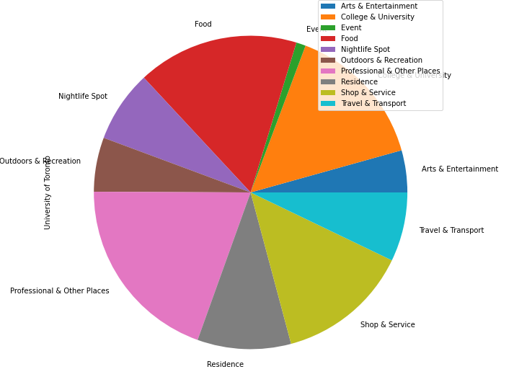
3. Exploratory Data Analysis
Pie chart of universities surrounding venues
Almost same number of Professional & Other places, Shop & Service, Residence and a small number of Event venues.
York University have a smaller number of Food and Nightlife Spots.

Slide 7
4. Conclusion
Have a business on food or nightlife fields at York University neighborhood is suggested.
Reasons:
Less food and nightlife businesses
Professional & other places and Residence are higher than other two area - potential clients in this area
Transportation facilities are also a guarantee for the customer flow volume.

